Slide 1
Lecture set 2LS 1201

Slide 2
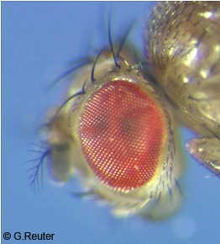
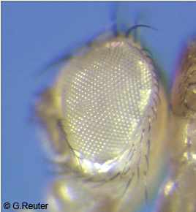
Wild type Vs Mutant
Wild type (or wildtype abbreviated wt) refers to the phenotype of the typical form of a species as it occurs in nature.
Large number in the population.
A mutant is an individual, organism that exhibits a new character or trait not found in the wild type.
Less frequent in the population
In genetics, the wild-type organisms serve as the original parent strain before a deliberate mutation is introduced (for research) so that geneticists can use them as reference to compare the naturally occurring genotypes and phenotypes of a given species against those of the deliberately mutated counterparts.

Slide 3
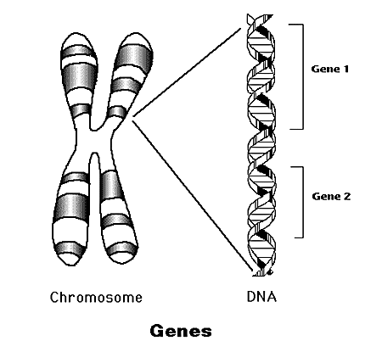
Genetic Information
Genome – the collection of genetic information.
Chromosomes – storage units of genes.
Gene – basic unit of genetic information. Genes determine the inherited characters.
DNA - is a nucleic acid that contains the genetic instructions specifying the biological development of all cellular forms of life
http://www.accessexcellence.com/AB/GG/

Slide 4
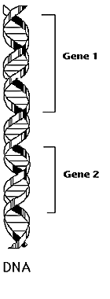
Chromosome Logical Structure
Locus – location of a gene/marker on the chromosome.
Allele –variants of a gene/marker at a particular locus.
Locus1
Possible Alleles: A1,A2
Locus2
Possible Alleles: B1,B2,B3

Slide 5
What is an Allele ?
An allele is different forms of the DNA sequence of a particular gene. (variants of a gene)

Slide 6
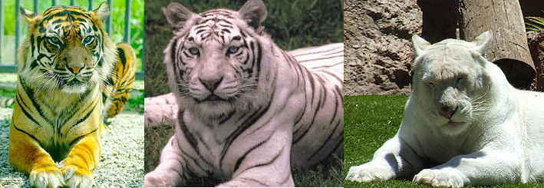
Wildtype and mutant allele
The allele that encodes the phenotype most common in a
particular natural population is known as the wild type allele.
It is often designated, in genetic shorthand, as "+” or WT
Any form of an allele other than the wild type is known as a mutant form of that allele.
Wildtype / +
white tiger
albino tiger

Slide 7
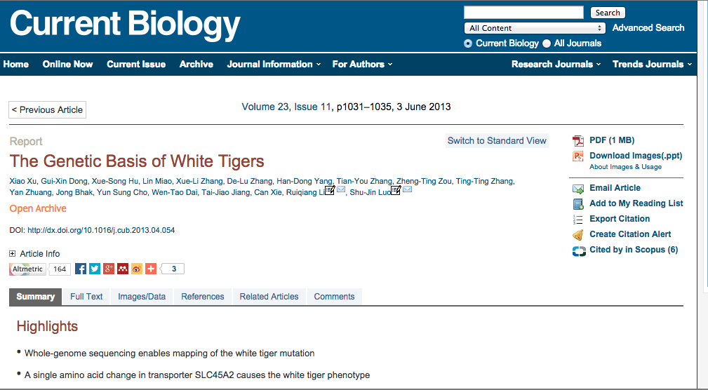
The gene variant found in the white tiger primarily inhibits the synthesis of red and yellow pigments but has little to no effect on black, which explains why white tigers still show characteristic dark stripes.

Slide 8
Symbols And Terminology
Wild type- For a given pair of alternate trait that is more frequent in a population (+/+)
Mutant- Alternate form of trait rare in natural population.
i) Dominant Allele: Upper case letter (A)
ii) Recessive Allele: Lower case letter (a)

Slide 9
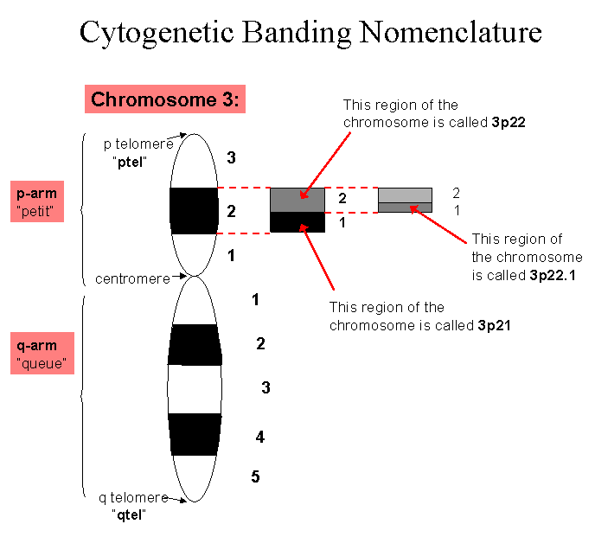
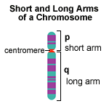
Genetic Locus
A locus (plural loci) is the specific location of a gene, DNA sequence, or position on a chromosome

Slide 10
Chromosome Logical Structure
Locus – location of a gene/marker on the chromosome.
Allele –variants of a gene/marker at a particular locus.
Locus1
Possible Alleles: A1,A2
Locus2
Possible Alleles: B1,B2,B3

Slide 11
Alleles
ABO locus - chromosome 9,
Contains seven exons that span more than 18 kb of genomic DNA.
The ABO locus has three main allelic forms: A, B, and O.

Slide 12
ABO system
ABO gene encodes an enzyme glycosyl transferase.
Modifies the oligosaccharide on cell surface glycoprotein
A allele adds N-acetyl galactosamine
B allele adds galactose
o allele is deletion which lacks the glycosyl transferase activity.

Slide 13
Differences between Gene & Allele
Genes are something we inherit from our parents. While Alleles determine how they are expressed in an individual.
Alleles occur in pairs but there is no such pairing for genes.
Alleles determine the traits we inherit.
The genes we inherit are the same for all humans. However, how these manifest themselves is actually determined by alleles!

Slide 14
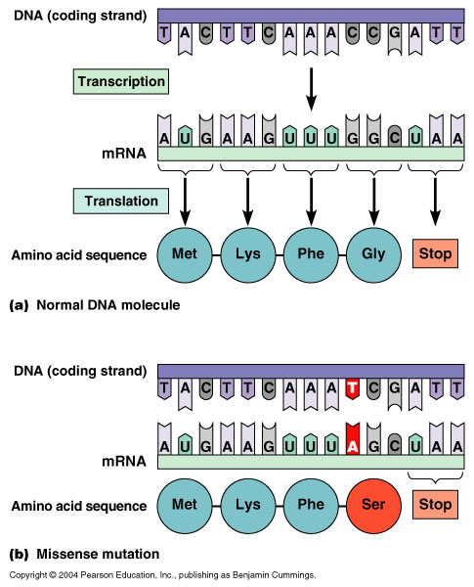
GENE
Allele

Slide 15
Exercise
How will you determine if a trait is dominant or recessive in a population?

Slide 16
Mendelian Inheritance

Slide 17
Birth of Genetics
Gregor Mendel was not the first to perform hybridization expts but he uniquely studied the results in terms of single traits
Mendel’s predecessors considered the whole organism resulting in complex of traits that was difficult to interpret.
Mendel’s work got recognition in 1900 when three botanists, Hugo De Vries, Carl Corens and Tschermak rediscovered Mendel’s principle of inheritance.

Slide 18
Traits Analyzed by Mendel
Mendel observed seven pea plant traits that are easily recognized in one of two forms:
1. Flower color: purple or white
2. Flower position: axial or terminal
3. Stem length: long or short
4. Seed shape: round or wrinkled
5. Seed color: yellow or green
6. Pod shape: inflated or constricted
7. Pod color: yellow or green

Slide 19
Mendelian Inheritance
The laws of inheritance were derived in 19th century by Johann Gregor Mendel, a monk conducting hybridization experiments in garden peas (Pisum sativum)
Law of Segregation
Law of Independent Assortment

Slide 20
Genotypes Phenotypes
At each locus (except for sex chromosomes) there are 2 alleles of a gene. These constitute the individual’s genotype at the locus (like Aa or Tt)
The expression of a genotype is termed a phenotype. For example, hair color, weight, or the presence or absence of a disease.

Slide 21
Principle of Segregation

Slide 22
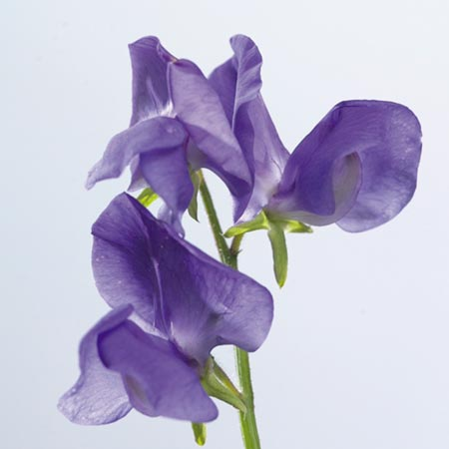
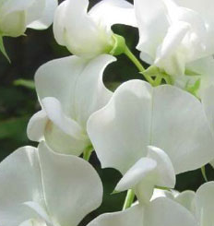
Mendel’s Experiment
X
F1 Generation
(Self Cross)
F2 Generation
Ratio 3:1
787
277
Total progeny - 1064

Slide 23
Specific entities or factors responsible each individual trait.
The factor specifying one of the traits has a dominating effect, overiding the other factor in F1 generation.
Trait expressed in the F1 is dominant
Masked trait is recessive

Slide 24
How can you explain this?

Slide 25
Mendel’s Experiment
X
AA
aa
Gametes
A
a
F1 Generation
Gametes
(Self Cross)
A
a
A
AA
Aa
Aa
a
Aa
aa
F2 Generation
Ratio 1(Violet only)
:2 (both violet & white)
:1 (white only)
AA
Aa
aa

Slide 26
Mendel prediction!!
Meiosis was discovered and described for the first time in sea urchin eggs in 1876 by the German biologist Oscar Hertwig.
It was described again in 1883, at the level of chromosomes, by the Belgian zoologist Edouard Van Beneden, in Ascaris worms' eggs.

Slide 27
Chromosome segregation
Inheritance of traits from parent to offspring
Mitosis
Meiosis

Slide 28
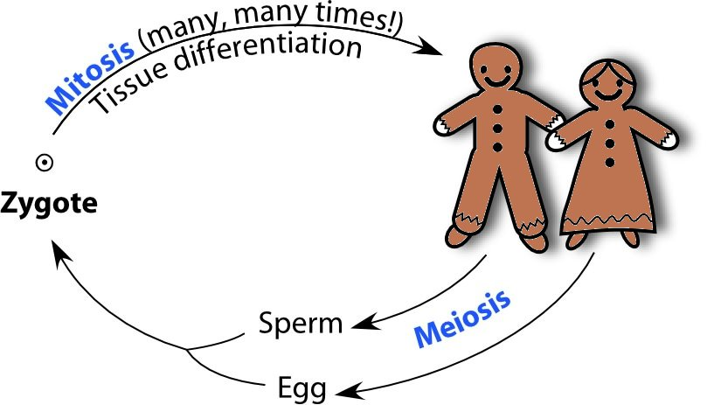
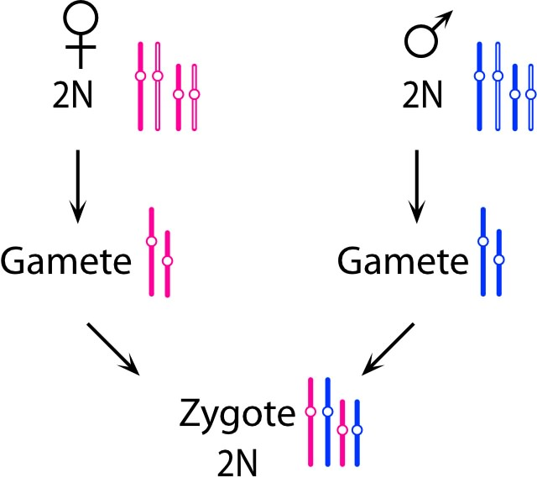
Meiosis—to halve the ploidy for gametes
Each parent has 2 copies of every chromosome… but each gamete must have only 1 copy of each chromosome
Homologous= Homo + Logous
Same + Shape
3 other combinations possible!

Slide 29
Mendel’s Experiment
X
AA
aa
Gametes
A
a
F1 Generation
Gametes
(Self Cross)
A
a
A
AA
Aa
Aa
a
Aa
aa
F2 Generation
Ratio 1(Violet only)
:2 (both violet & white)
:1 (white only)
AA
Aa
aa

Slide 30
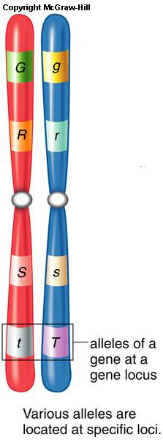
HETEROZYGOUS- having two different alleles for a given trait (the allele inherited from the mother is different from the allele inherited from the father). Like Aa
HOMOZYGOUS- having identical alleles for a trait (the allele inherited from the mother is identical to the allele inherited from the father). Like AA, aa

Slide 31
Law of Segregation states that when any individual produces gametes, the alleles separate, so that each gamete receives only one allele. A gamete will receive one allele or the other.

Slide 32
How do you know if the genotype of an individual is homozygous or heterozygous?
AA or Aa ?

Slide 33
Test Cross!!!
Test Cross is used to determine if an individual exhibiting a dominant trait is homozygous or heterozygous for that trait.
Test crosses involve breeding the individual in question with another individual that expresses a recessive version of the same trait.

Slide 34
Schematic of Test Cross.
X
AA
Aa
aa
F1 Generation
Aa
Aa
aa
Ratio 1:1

Slide 35
Back Cross
Backcrossing is a crossing of a hybrid with one of its parents or an individual genetically similar to its parent, in order to achieve offspring with a genetic identity which is closer to that of the parent.
It is used in horticulture, animal breeding etc

Slide 36
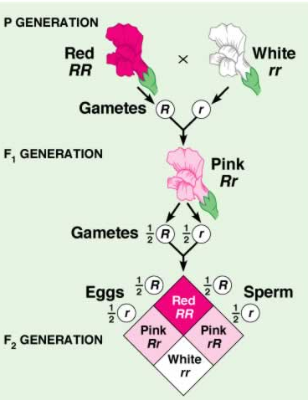
Incomplete or semidominance
Incomplete dominance is a form of intermediate inheritance in which one allele for a specific trait is not completely dominant over the other allele.
This is because the semidominant allele produces the gene product in a lesser amount

